Slide 1


Library Management System
Python project

Slide 2
Project Team members
Name | Lab
Ziad Elsayed Abdelazim (Team Leader) | 3
Ziad Mohamed | 3
Ziad Adel | 3
Reham Ibrahim Abdeldayem | 3
Sohaila Ibrahim Ramadan | 3
Ru’a Ayman Mohamed | 3

Slide 3
Project overview
Project overview:
Libraries range in size from a few shelves to large buildings with a huge collection of knowledge not only books ,but maps ,periodicals, and other data storage sources, so we did a system to make libraries easier to work with libraries are divided into two basic types ,and they are private and public libraries. In this project we’re dealing with public libraries.in this sys we use(Tkinter, database ,fun ,class ,constructor , pil, treeview, canvas and photo image ).

Slide 4
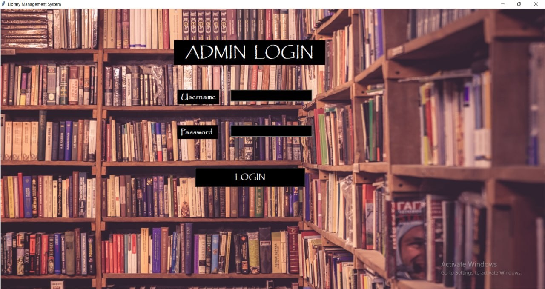
Login Page
Login Frame is the first interface in the system
login screen is the frame for admin login .there are(two labels ,two entries , one button).
admin should enter his username and password to login if information is true.by pressing on login ,second frame will appear.

Slide 5

Home Page
In this frame there are(two labels(book data and student data)).
admin should choose which data he wants.
by clicking on book data,3rd frame will appear .
By clicking on student data ,4th frame will appear.

Slide 6

Book Data Frame
In this frame there are (6 labels ,6 entries and 6 buttons).
Add book for adding new books.
Search for a book in the library.
Update data of books in the library.
Delete books .
Showing all books in the library .

Slide 7

Student Frame
In this frame there are 7 labels , 2 entries and 3 buttons).
Issue book
Return book
Student Activity

Slide 8
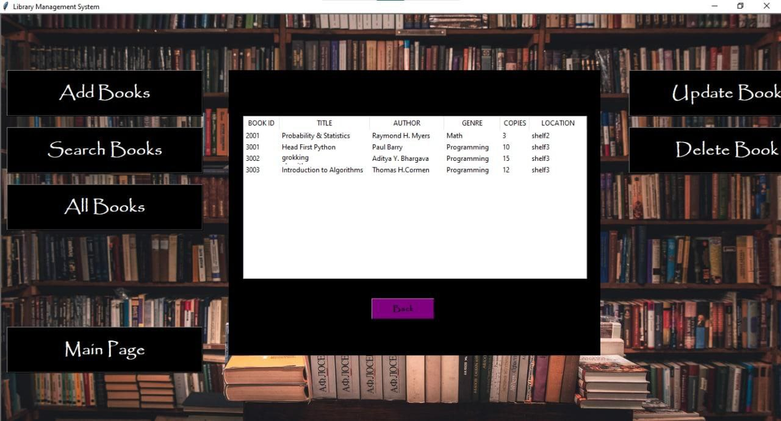
Data Of Books
This table shows all data of books
Book id , title , author , genre , copies and location .
We used for this Treeview to show data of books in a table.

Slide 9
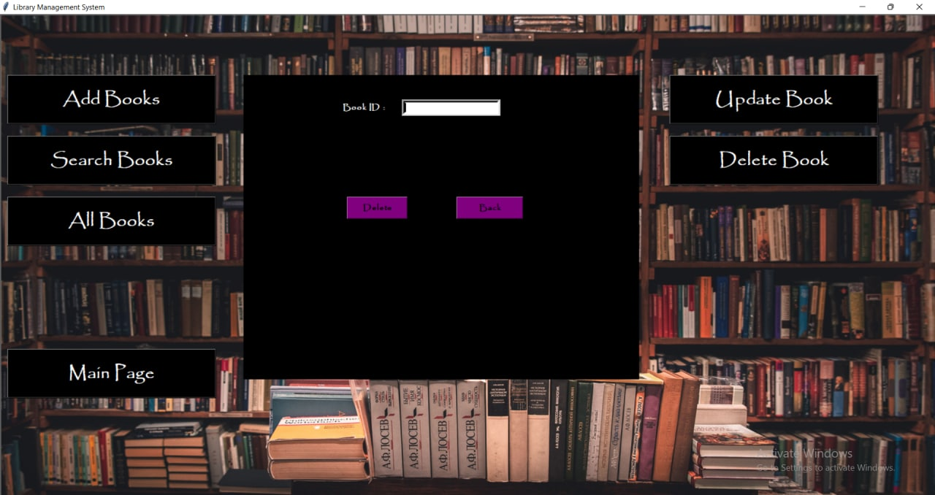
Deleting Books
In our system we can delete a book from the library by entering book id and clicking delete.

Slide 10
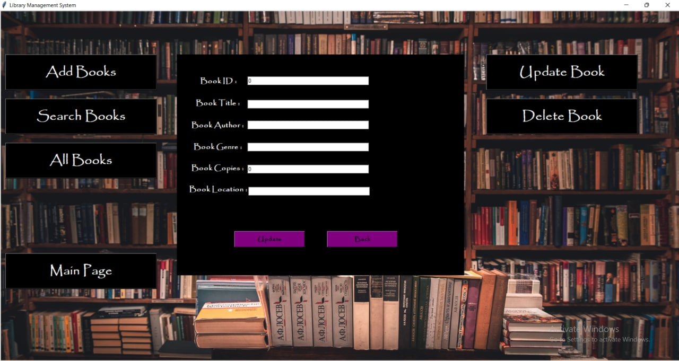
Updating Books
In our system we can update a book in the library by entering book id and other data .
For example ,we can update number of copies for a book .

Slide 11
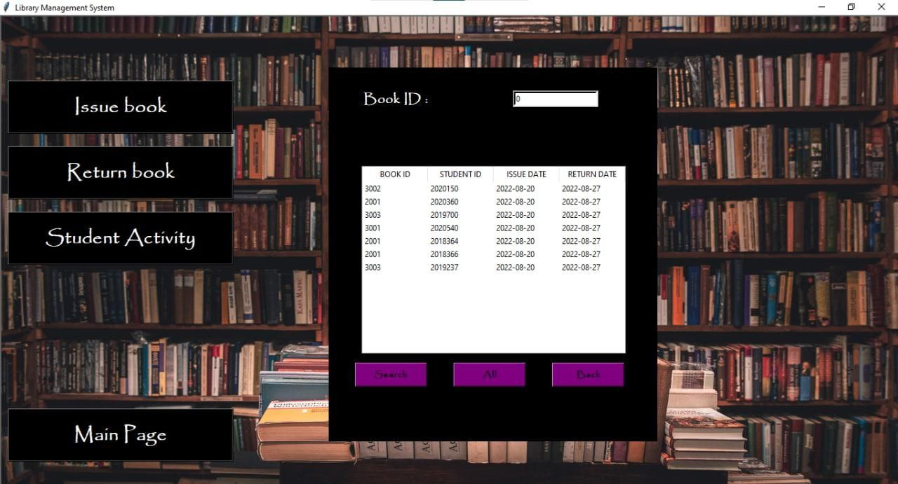
Data Of Students
This table shows all student activity .
Book id , Student id , Issue date and return date .
We used treeview to show data in a table .

Slide 12
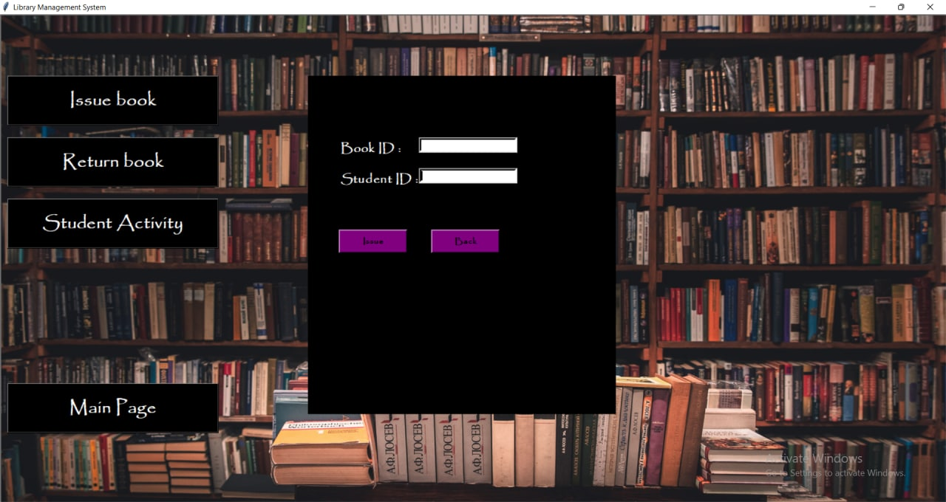
Issue books
In our system we can issue a book in the library by entering book id and student id .
Every student can return a book within 7 days.

Slide 13
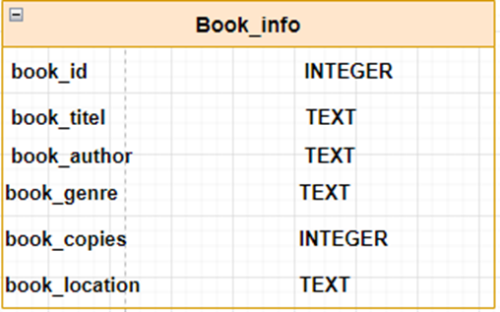
Database
Book info:
In this table there are 6 columns:-
book_id (PK) : to Store id for books.
book_title: to Store name title for books.
book_author: to Store name author for books.
book_genre: to Store Genre for books.
book_copies: to Store number of copies.
Book_location: To store the book location

Slide 14
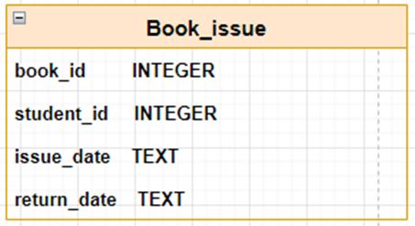
Book_issue:
In this table there are 4 columns :-
book_id: to Store id for books.
student_id : to Store id for students.
issue_date : to store the borrowing date
return_date: to store the return date

Slide 15
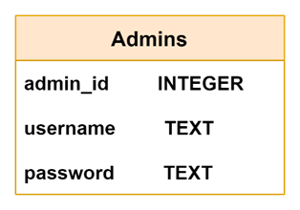

Admins :
In this table there are 4 columns :-
admin_id: to Store id for admin and it is auto increment .
username : to Store username for admins.
password : to store password for admins.

Slide 16
Thank You

